Slide 1


Potential of Strategic Marketing for Financial Services
Capstone AWS B4
Ashish Prajapati
Bhavesh Jain
Chandana J
Mayank Kishor Chawla
Mugundhan B
Tanmay Akkewar
July-September 2023

Slide 2
Contents
Contents.
Problem Statement 3
Approach 4
Tasks 1.1 and 1.2 5
Checkpoint 1 Deliverables 7
Tasks 2.1 and 2.2 12
Checkpoint 2 Deliverables 14

Slide 3
Problem Statement
HBCF bank recently conducted marketing campaigns to promote their in-term deposit scheme. They want to analyze the data and derive insights for better marketing campaign and thereby increasing their customer base
Deliverables
Approach
The motive is to deliver key insights and potential issues from the available data. Build predictive models to optimize the process of successful and unsuccessful campaigns and delivery it to the client
Checkpoints
Analysis using Python and SQL
Analysis using Power BI and Big Data Tools
Analysis, Modelling and Deployment
Delivery
Notes:
Sophia 35

Slide 4
Approach
Understanding the data provided, pre-processing the data and deriving insights from it
01
Building various predictive models, comparing the accuracy of all the models, testing and deploying the best possible model
02
Delivery the final product to the client
03
Notes:
Van 1

Slide 5
Checkpoint 1
Python
Percentage turnout of marketing campaign
Mode of contact
Attempts made to for a successful customer
Personal background impact on marketing campaigns
Socio-economic analysis
Demographics and More..
1.1
1.2
SQL
Construct ER Diagrams
Find relationships between tables
Derive insights

Slide 6
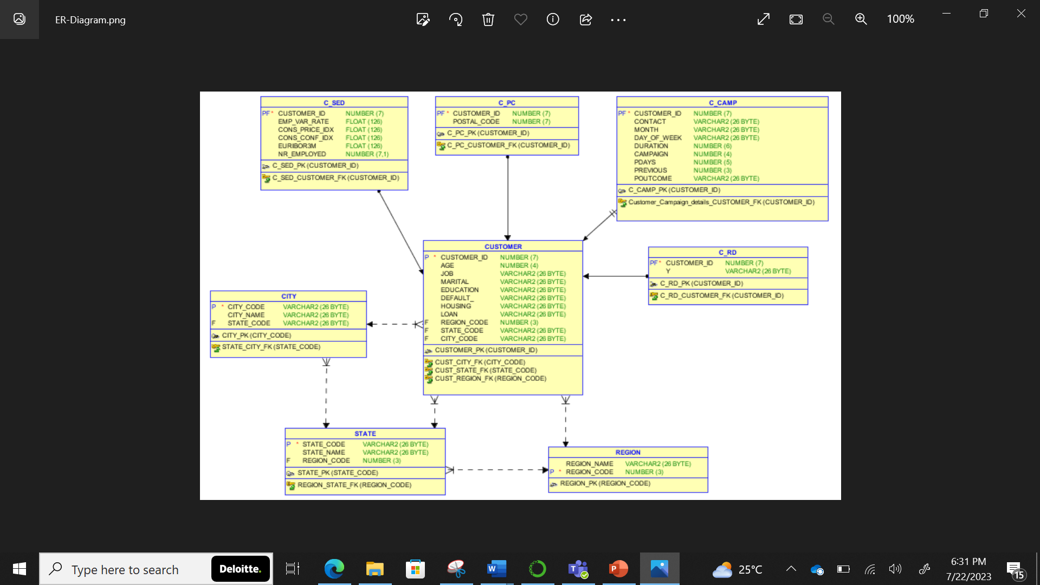
ER- Diagram
Notes:
Sophia 14

Slide 7
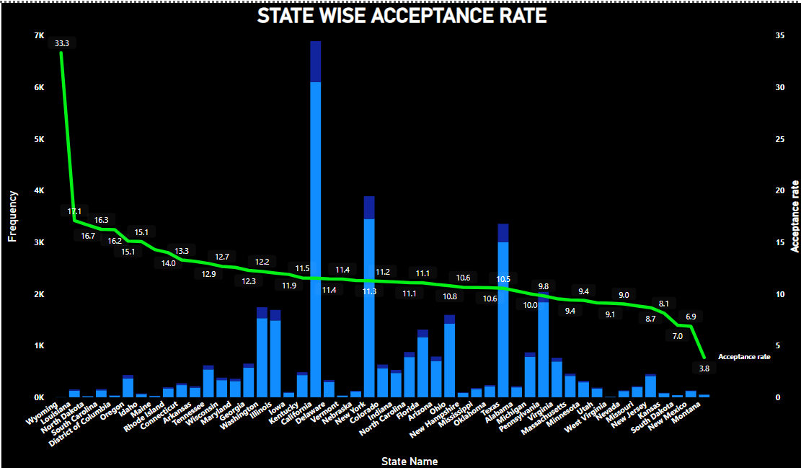
Insight-1 Few states which have less responses have got higher acceptance rate
Insight–2 Most of the responses are concentrated in the regions of California, New York, Texas, Pennsylvania
Action The states which have higher acceptance rate but more response can be made main focus area for future advertisement target. Also the states having very high frequency should be made aggressive offers to increase conversion rate
Notes:
Sophia 14

Slide 8
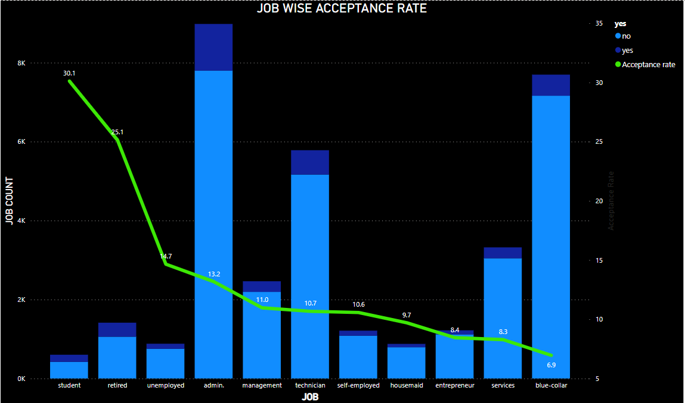
Insight - 1 Few job categories which have less responses have got higher acceptance rate
Insight - 2 Most of the responses are concentrated among the job categories such as admin, technician, blue collar, services
Action The job category which have higher acceptance rate but more response can be made main focus area for future advertisement target. Also the job categories having very high frequency should be made aggressive offers to increase conversion rate
Notes:
Sophia 14

Slide 9
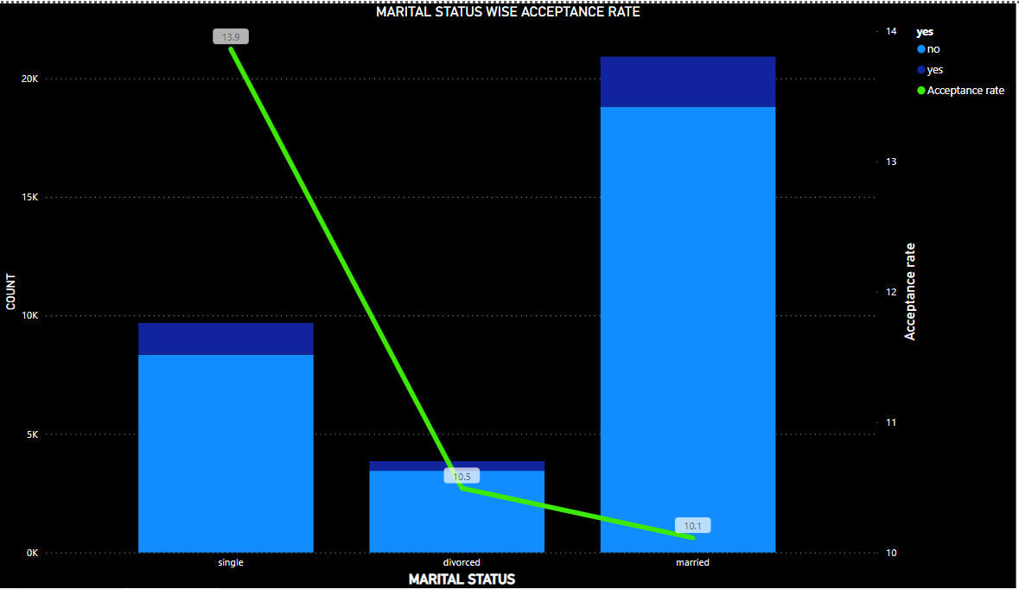
Insight – 1
“Single” category has highest ratio of frequency and acceptance rate
Insight - 2 ‘Married” category has highest responses but conversion rate is less.
Action More emphasis should be made on the ‘single’ category. Also few regressive offers can be made to married people to increase conversion rate.
Notes:
Sophia 14

Slide 10
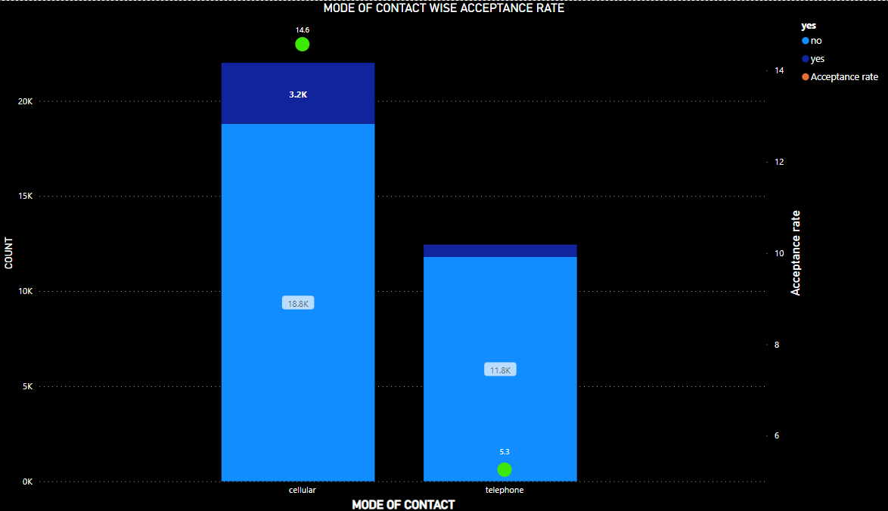
Insight - 1 Cellular mode of contact has highest ratio of frequency and acceptance rate
Insight - 1 Cellular contact were almost double as that of telephone
Action More cellular contacts should be made or a balance of two method based on economic reasons.
Notes:
Sophia 14

Slide 11
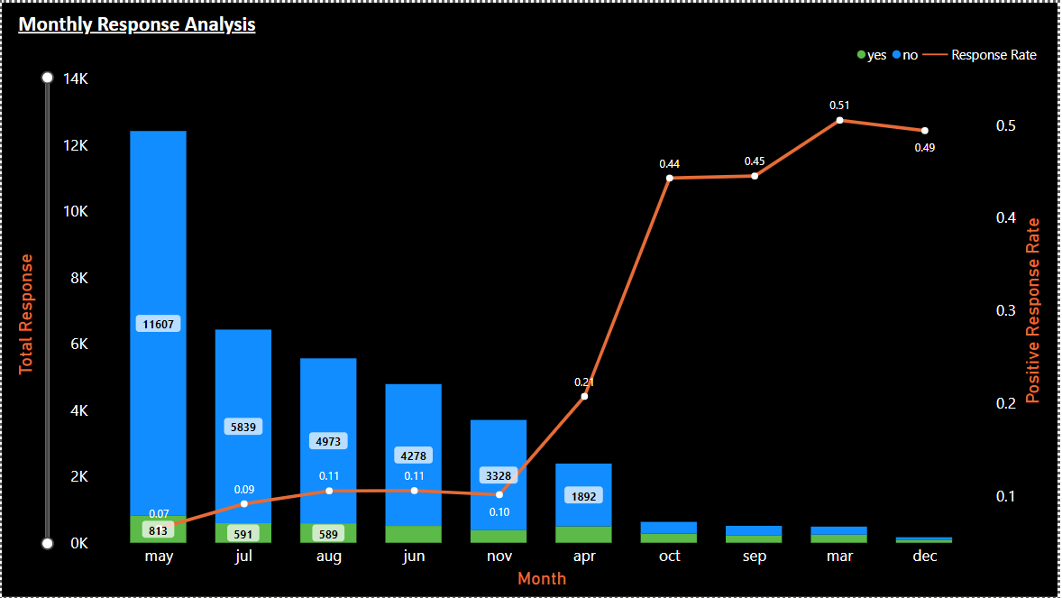
Monthly Response Analysis The variation in response rate and total response against each month is shown
Insight – 1 Most of the contact was made in the month of May and least in the month of December
Insight – 2 The rate of response of was highest in the month of March but, the total response were also on the lower side. A good response and total response is seen in the month of April
Notes:
Sophia 14

Slide 12
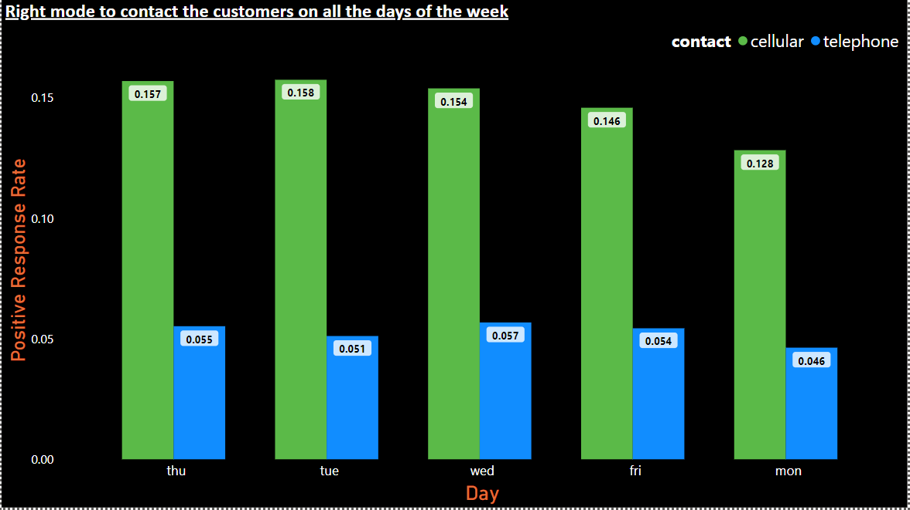
Mode of contact with Days of Week The Mode of Contact (Telephone/ Cellular) against the Days of the Week
Insight – 1 Most of the contacts were made through Cellular with an average success rate of 15%. which also yielded higher relative positive responsive
Insight – 2 Thursday and Tuesday were the days in which response was the highest(almost 16%). Starting and ending of the week response was the lowest(5%).
Notes:
Sophia 14

Slide 13
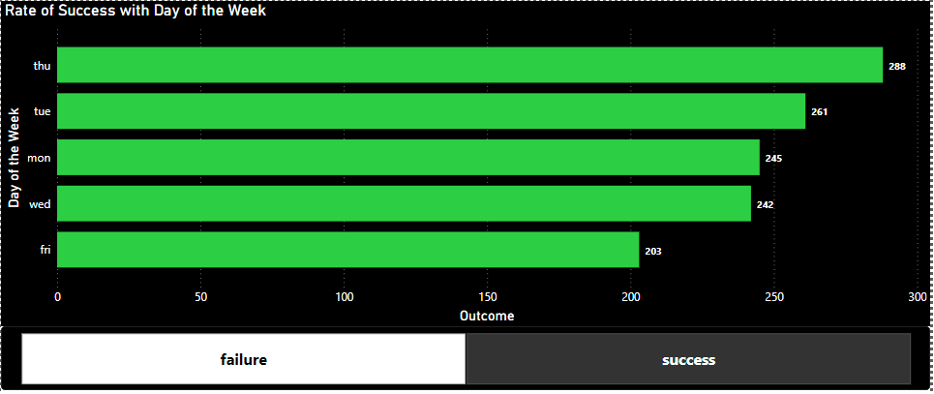
Rate of Success with day of the week This is similar to an earlier comparison, but with success only
Insight – 1 Similar to earlier comparison Thursday and Tuesday were the most productive days
Insight – 2 While Monday as seen earlier were less contacts were made but also turns out to be third productive day of the week. Response was poor on friday
Notes:
Sophia 14

Slide 14
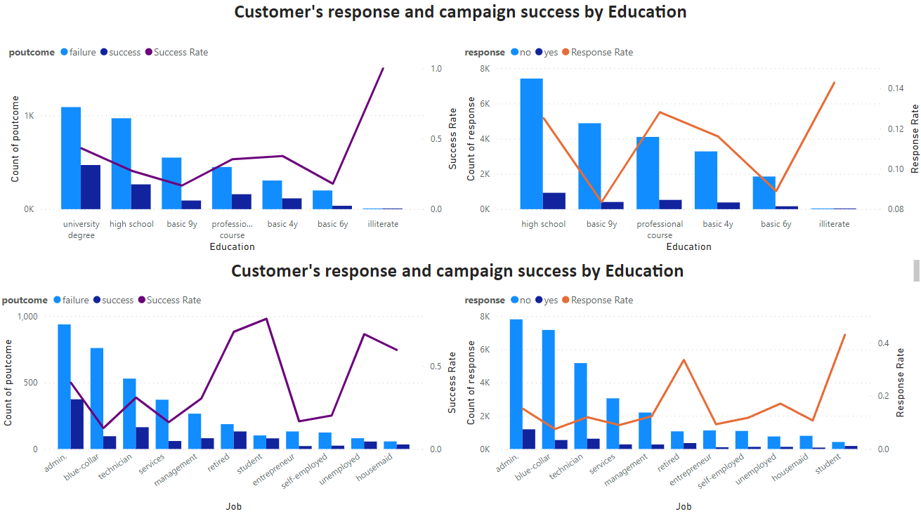
Campaign Success by Education and Job Campaign success compared to education and professional background
Insight – 1 Response rates were in the higher side if the customer had done a professional course
Insight – 2 In terms of Professional background retired personnel and students gave a higher positive response
Notes:
Sophia 14

Slide 15
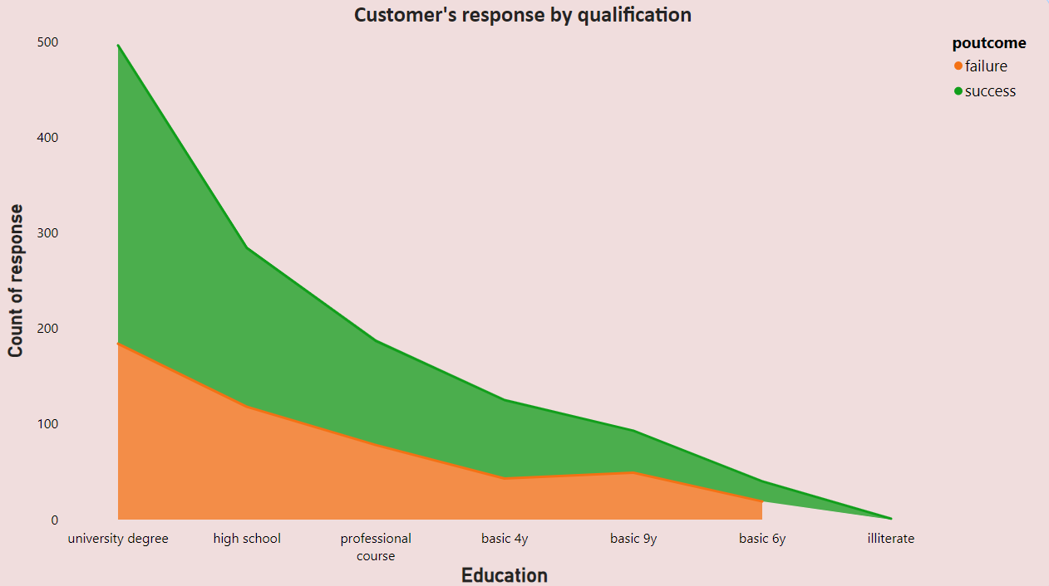
Customer Response by Qualification Number of customers by education background was analyzed
Insight – 1 Most of the customers contacted had a university degree. Illiterates were less contacted
Insight – 2 Seen earlier success rate was high with professional course and illiterates
Notes:
Sophia 14

Slide 16
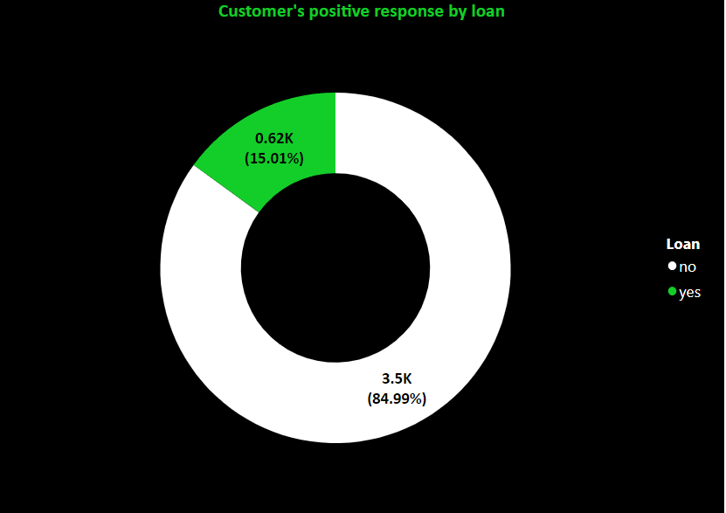
Customer Response for Term-deposit The representation shows if the customer with positive response had accepted the term deposit
Insight – 1 The success rate was just about 15%
Notes:
Sophia 14

Slide 17
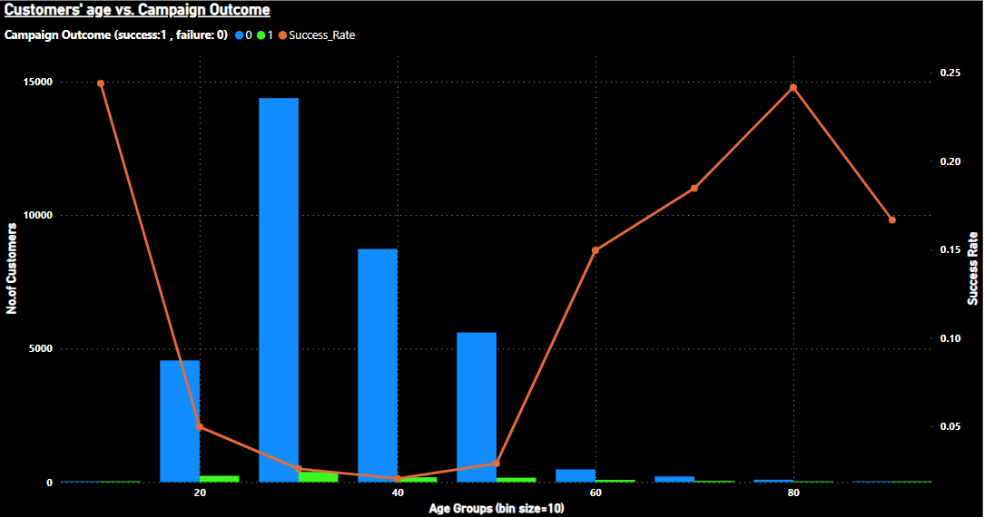
Customer Age against the Campaign Outcome Variation of campaign success customer among different age groups of customers is shown
Insight – 1 Most of the customers were middle aged. We have more success outcome from 10-20 and >=60 years old age groups
Insight – 2 Teenagers as well as aged customers are interested in term deposits for future and retirement purposes. Middle ages might be less interested since they are actively earning
Notes:
Sophia 14

Slide 18
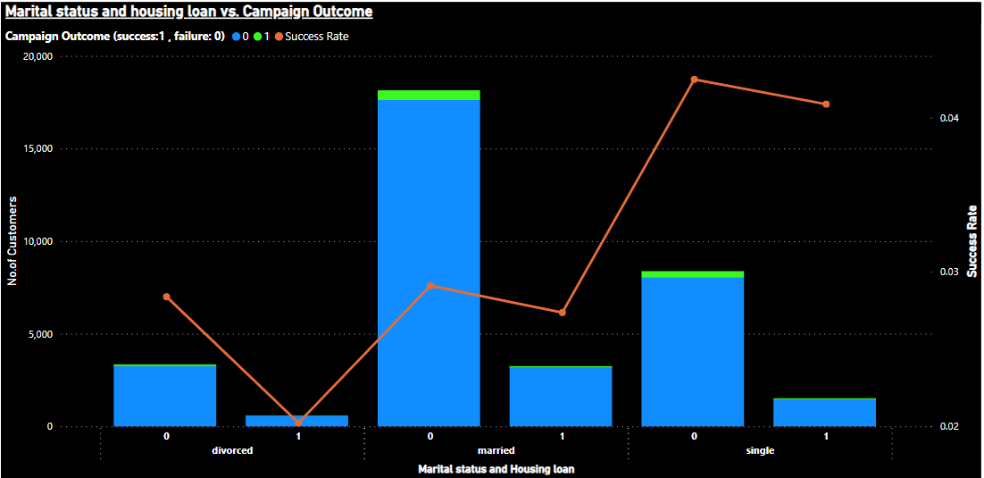
Martial Status and housing loan against campaign outcome Martial status divided as divorced, single and married
Insight – 1 Most of the contact were made to married customers
And the success rate is more among single customers without housing loan.
Insight – 2 It is always a better idea to contact customers with no housing loan. Divorcees give the least success rate among all since their needs may be less than others.
Notes:
Sophia 14

Slide 19
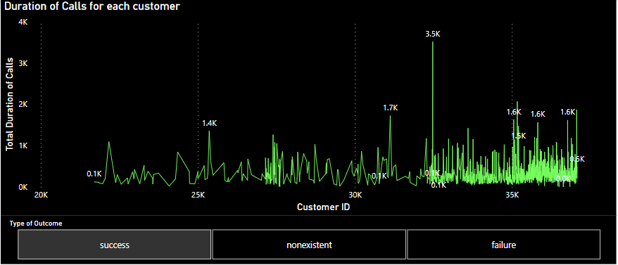
Total duration of calls against each customer The representation shows the total duration of calls against each customer
Insight – 1 The representation includes successful and failure calls
Insight – 2 The maximum duration for a successful response is about 3500 seconds
Notes:
Sophia 14

Slide 20
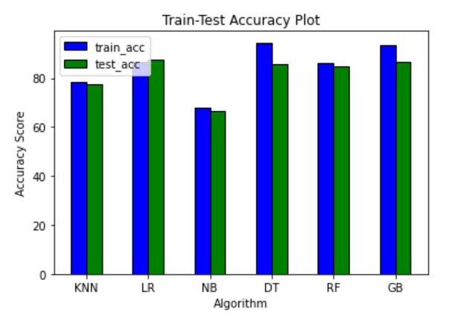
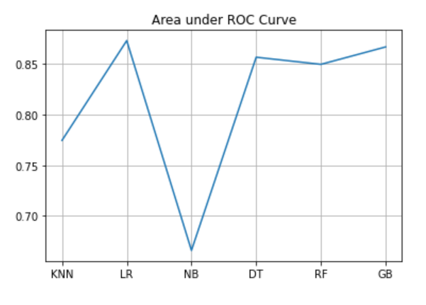
List of predictive models used for model training
KNN
Logistic Regression
Naïve Bayes
Decision Tree
Random Forest
Gradient Boosting
Insight – 1 The first graph shows the accuracy of each model. Whereas the second graph i.e., AUC provides an aggregate measure of performance of the model.
Insight – 2 Looking at above two plots we are good to go with Gradient Boosting algorithm given high AUC and high train test accuracy
Notes:
Sophia 14

Slide 21
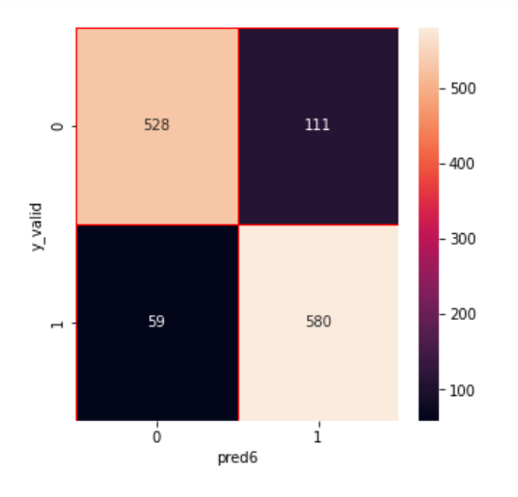
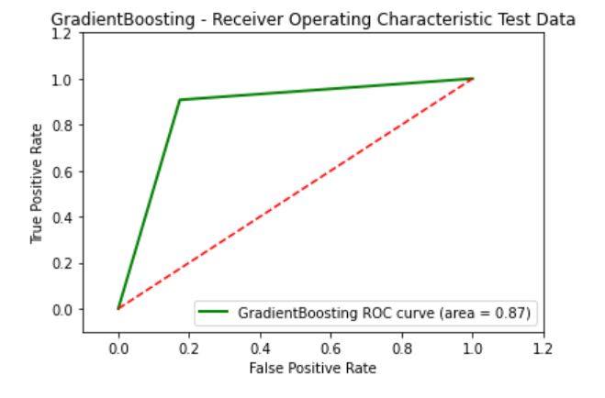
Gradient Boosting
Ensemble Learning: Gradient Boosting is an ensemble learning technique that combines multiple weak learners, often decision trees, to create a strong predictive model.
Sequential Improvement: It iteratively builds new learners to correct the errors made by the existing ensemble, placing more emphasis on misclassified instances.
Insight – 1 From the confusion matrix, the TP, FP, FN and TN count is 528, 111, 59 and 580 respectively. The accuracy of model is 87% and precision is 82.6%.
Insight – 2 The Receiver Operating Characteristics value is 0.87. This high value indicates that the model is able to distinguish between classes.
Notes:
Sophia 14

